Slide 1
Sorting
Fall 2024
School of Software Engineering
South China University of Technology

Slide 2

O(NlogN) Sorting Algorithms

Slide 3
Heap Sort
We use a Max-Heap
Root node = A[1]
Children of A[i] = A[2i], A[2i+1]
Keep track of current size N (number of nodes)
7
value
7
5
6
2
4
index
5
6
1
2
3
4
5
6
7
8
N = 5
2
4

Slide 4
Using Binary Heaps for Sorting
Build a max-heap
Do N DeleteMax operations and store each Max element as it comes out of the heap
Data comes out in largest to smallest order
Where can we put the elements as they are removed from the heap?
Build
Max-heap
DeleteMax
7
6
5
6
5
4
2
4
2
7

Slide 5
1 Removal = 1 Addition
Every time we do a DeleteMax, the heap gets smaller by one node, and we have one more node to store
Store the data at the end of the heap array
Not "in the heap" but it is in the heap array
value
6
5
4
2
7
6
index
1
2
3
4
5
6
7 8
5
4
N = 4
2
7

Slide 6
Repeated DeleteMax
5
2
4
6
7
1
2
3
4
5
6
7 8
N = 3
5
2
4
6
7
4
2
5
6
7
1
2
3
4
5
6
7 8
N = 2
4
2
5
6
7

Slide 7
Heap Sort is In-place
After all the DeleteMaxs, the heap is gone but the array is full and is in sorted order
value
2
4
5
6
7
index
1
2
3
4
5
6
7
8
N = 0
2
4
5
6
7

Slide 8
Heapsort: Analysis
Running time
time to build max-heap is O(N)
time for N DeleteMax operations is N O(log N)
total time is O(N log N)
Can also show that running time is Ω(N log N) for some inputs,
so worst case is Θ(N log N)
Average case running time is also O(N log N)
Heapsort is in-place but not stable (why?)
Consider (2a,2b,2c)

Slide 9
“Divide and Conquer”
Very important strategy in computer science:
Divide problem into smaller parts
Independently solve the parts
Combine these solutions to get overall solution
Idea 1: Divide array into two halves, recursively sort left and right halves, then merge two halves → Mergesort
Idea 2 : Partition array into items that are “small” and items that are “large”, then recursively sort the two sets → Quicksort

Slide 10
MergeSort
Divide it in two at the midpoint
Conquer each side in turn (by recursively sorting)
Merge two halves together
8
2
9
4
5
3
1
6

Slide 11
Mergesort Example
8
2
9
4
5
3
1
6
Divide
8 2 9 4
5 3 1 6
Divide
8 2
9 4
5 3
1 6
Divide
1 element
8 2 9 4 5 3 1 6
Merge
2 8 4 9 3 5 1 6
Merge
2 4 8 9 1 3 5 6
Merge
1 2 3 4 5 6 8 9

Slide 12
Auxiliary Array
The merging requires an auxiliary array.
2
4
8
9
1
3
5
6
1
2
3
4
5
6
8
9
Auxiliary array

Slide 13
Merging
i
j
normal
target
Left completed
first
copy
i
j
target

Slide 14
Merging
①
Right completed
first
②
i
j
target

Slide 15
Merging Algorithm
/**
* pseudo code for Merging Algorithm in MergeSort
**/
Merge(A[], T[] : integer array, left, right : integer) {
mid, i, j, k, l, target : integer;
mid := (right + left)/2;
i := left; j := mid + 1; target := left;
while i < mid and j < right do
if A[i] < A[j] then T[target] := A[i] ; i:= i + 1;
else T[target] := A[j]; j := j + 1;
target := target + 1;
if i > mid then //left completed//
for k := left to target-1 do A[k] := T[k];
if j > right then //right completed//
k : = mid; l := right;
while k > i do A[l] := A[k]; k := k-1; l := l-1;
for k := left to target-1 do A[k] := T[k];
}

Slide 16
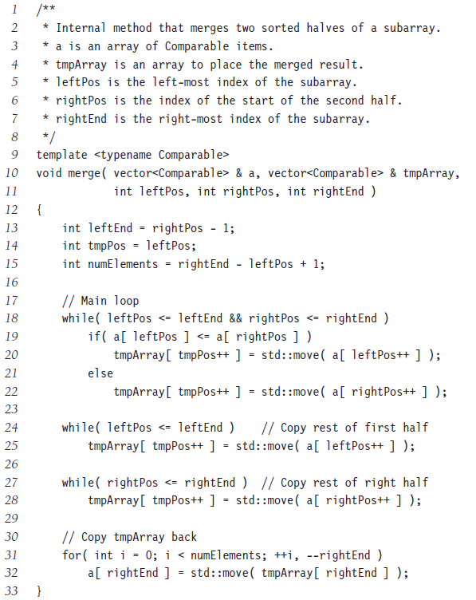

Slide 17
Recursive Mergesort
/**
* Recursive implementation for Mergesort
**/
Mergesort(A[], T[] : integer array, left, right : integer) : {
if left < right then
mid := (left + right)/2;
Mergesort(A,T,left,mid);
Mergesort(A,T,mid+1,right);
Merge(A,T,left,right);
}
//Driver
MainMergesort(A[0..n-1]: integer array, n : integer) : {
T[0..n-1]: integer array;
Mergesort[A,T,0,n-1];
}

Slide 18
Another Impl for Mergesort
Make use of Insertion Sort to sort small arrays.
No test is needed to check for when one of the two subarrays becomes empty

Slide 19
Another Impl for Mergesort
template <typename E, typename Comp>
void mergesort(E A[], E temp[], int left, int right) {
if ((right-left) <= THRESHOLD) { //small list
insertionsort<E,Comp>(&A[left], right-left+1);
return;
}
int i, j, k, mid = (left+right)/2;
if (left == right) return;
mergesort<E, Comp>(A, temp, left, mid);
mergesort<E, Comp>(A, temp, mid+1, right);
//Do the merge operation. First copy two halves to temp
for (i=mid; i>=left; i--) temp[i] = A[i];
for (j=1; j<=right-mid; j++) temp[right-j+1] = A[j+mid]; // reverse order
//Merge sublists back to A
for (i=left, j=right, k=left; k<=right; k++)
if (Comp::prior(temp[i], temp[j])) A[k] = temp[i++];
else A[k] = temp[j--];
}
 | 0 | 1 | 2 | 3 | 4 | 5 | 6
Temp | A[0] | A[1] | A[2] | A[3] | A[6] | A[5] | A[4]

Slide 20
Another Impl for Mergesort
template <typename E, typename Comp>
void mergesort(E A[], E temp[], int left, int right) {
if ((right-left) <= THRESHOLD) { //small list
insertionsort<E,Comp>(&A[left], right-left+1);
return;
}
int i, j, k, mid = (left+right)/2;
if (left == right) return;
mergesort<E, Comp>(A, temp, left, mid);
mergesort<E, Comp>(A, temp, mid+1, right);
//Do the merge operation. First copy two halves to temp
for (i=mid; i>=left; i--) temp[i] = A[i];
for (j=1; j<=right-mid; j++) temp[right-j+1] = A[j+mid];
//Merge sublists back to A
for (i=left, j=right, k=left; k<=right; k++)
if (Comp::prior(temp[i], temp[j])) A[k] = temp[i++];
else A[k] = temp[j--];
}

Slide 21
Mergesort Analysis
Let T(N) be the running time for an array of N elements
Mergesort divides array in half and calls itself on the two halves. After returning, it merges both halves using a temporary array
Each recursive call takes T(N/2) and merging takes O(N)

Slide 22
Mergesort Recurrence Relation
The recurrence relation for T(N) is:
T(1) = a
base case: 1 element array → constant time
T(N) = 2T(N/2) + bN
Sorting N elements takes
the time to sort the left half
plus the time to sort the right half
plus an O(N) time to merge the two halves
How to calculate T(N) ?

Slide 23

Mergesort Analysis
One calculation
Divide the T(N) = 2T(N/2)+bN through by N
$$\frac{T\left(N\right)}{N}=\frac{T\left(N/2\right)}{N/2}+b$$
$$\frac{T\left(N/2\right)}{N/2}=\frac{T\left(N/4\right)}{N/4}+b$$
$$\frac{T\left(N/4\right)}{N/4}=\frac{T\left(N/8\right)}{N/8}+b$$
…
$$\frac{T\left(2\right)}{2}=\frac{T\left(1\right)}{1}+b$$
add up all the equations,then
$$\frac{T\left(N\right)}{N}=\frac{T\left(1\right)}{1}+blogN=a+blogN$$
$$T\left(N\right)=aN+bNlogN$$
So, T(N) = O(n log n)

Slide 24
Properties of Mergesort
Not in-place
Requires an auxiliary array (O(n) extra space)
Stable
Make sure that left is sent to target on equal values.

Slide 25
Quicksort
Quicksort uses a divide and conquer strategy, but does not require the O(N) extra space that MergeSort does
Partition array into left and right sub-arrays
Choose an element of the array, called pivot
the elements in left sub-array are all less than pivot
elements in right sub-array are all greater than pivot
Recursively sort left and right sub-arrays
Concatenate left and right sub-arrays in O(1) time

Slide 26
“Four easy steps”
To sort an array S
1. If the number of elements in S is 0 or 1, then return. The array is sorted.
2. Pick an element v in S. This is the pivot value.
3. Partition S-{v} into two disjoint subsets, S₁ = {all values x≤v}, and S₂ = {all values x≥v}.
4. Return QuickSort(S₁), v, QuickSort(S₂)

Slide 27
The steps of QuickSort
S
81
43
31
57
select pivot
13
75
92
0
65
26
S₁
S₂
0
31
75
partition S
13
43
65
92
81
26
57
S₁
S₂
QuickSort(S₁) &
QuickSort(S₂)
0
13
26
31
43
57
65
75
81
92
S
0
13
26
31
43
57
65
75
81
92
S is sorted

Slide 28
Partitioning
Picking the pivot
want a value that will cause |S₁| and |S₂| to be non-zero, and close to equal in size if possible
Partitioning Strategy
How do the elements get to the correct partition

Slide 29
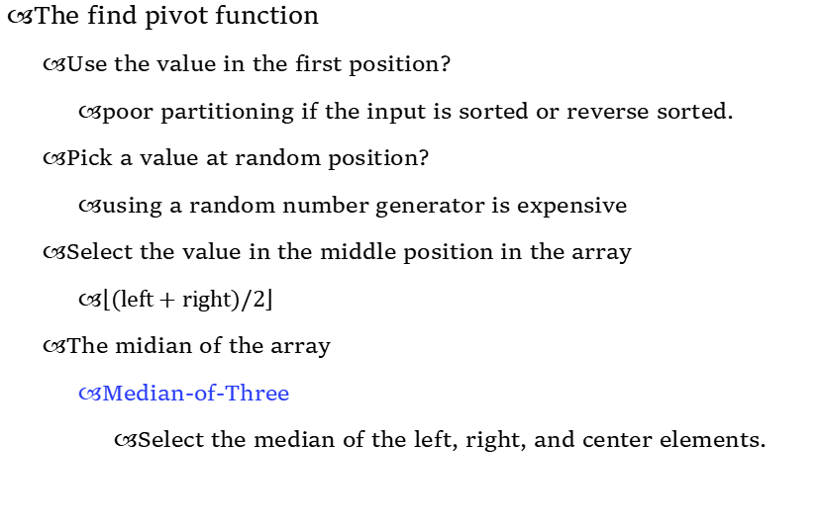
Select pivot
The find pivot function
Use the value in the first position?
poor partitioning if the input is sorted or reverse sorted.
Pick a value at random position?
using a random number generator is expensive
Select the value in the middle position in the array
$\left\lfloor \text{(}\text{left}\text{ + }\text{right}\text{)/}\text{2}\right\rfloor$
The midian of the array
Median-of-Three
Select the median of the left, right, and center elements.

Slide 30
Partitioning Strategy
Several partitioning strategies used in practice
Digging and filling
3-way partitioning
……
2-way partitioning (we discuss)

Slide 31
2-way partitioning
Set pointers i and j to start and end of array
Increment i until you hit element A[i] > pivot
Decrement j until you hit element A[j] < pivot
Swap A[i] and A[j]
Repeat until i and j cross
Swap pivot (at A[N-1]) with A[i]

Slide 32
Example
0
1
2
3
4
5
6
7
8
9
8
1
4
9
6
3
5
2
7
0
Choose the pivot using Median-of-Three
8
1
4
9
0
3
5
2
7
6
i
j
Swap the pivot with last element A[N-1].

Slide 33
Example
8
1
4
9
0
3
5
2
7
6
i
j
Increment i until you hit element A[i] > pivot
8
1
4
9
0
3
5
2
7
6
i
j
Decrement j until you hit element A[j] < pivot
8
1
4
9
0
3
5
2
7
6
i
j
Swap A[i] and A[j]
2
1
4
9
0
3
5
8
7
6
i
j

Slide 34
Example
2
1
4
9
0
3
5
8
7
6
i
j
2
1
4
9
0
3
5
8
7
6
i
j
2
1
4
5
0
3
9
8
7
6
i
j
2
1
4
5
0
3
9
8
7
6
j
i
Cross-over i > j
2
1
4
5
0
3
6
8
7
9
S₁ < pivot
pivot
S₂ > pivot

Slide 35
Quicksort
//QuickSort
template <typename E, typename Comp>
void quickSort(E A[], int i, int j) {
if (j <= i) return; //List with 0 or 1 element
int pivotindex = findpivot(A, i, j); //get pivot
swap(A, pivotindex, j); //Put pivot at end
//k will be the 1st position on right side
int k = partition<E,Comp>(A, i, j-1, A[j]);
swap(A, k, j); // Put pivot in place
quickSort<E,Comp>(A, i, k-1); //Recursively
quickSort<E,Comp>(A, k+1, j);
}

Slide 36
Quicksort
template <typename E, typename Comp>
int partition(E A[], int l, int r, E& pivot) {
do {
//Move the bounds inward until they meet
//Move l right and r left
while (Comp::prior(A[++l], pivot));
while ((l<r) && Comp::prior(A[--r],pivot));
// Swap out-of-place values
swap(A, l, r);
} while (l < r); // Stop when they cross
swap(A, l, r); // Reverse last swap[最后一次交换是多余的]
return l; //Return 1st position in right part
}

Slide 38
Optimizations
Quicksort has more overhead for small arrays.
A good cutoff range is 10.(Empirical threshold)
Using insertion sort for small arrays.
Reduce recursive calls

Slide 39
Analysis of Quicksort
Assuming a random pivot and no cutoff for small arrays.
T(0) = T(1) = O(1)
constant time if 0 or 1 element
For N > 1, 2 recursive calls plus linear time for partitioning
T(N) = T(i) + T(N − i − 1) + cN

Slide 40
Analysis of Quicksort
Best Case
Algorithm always chooses best pivot and splits sub-arrays in half at each recursion
T(N) = 2T(N/2) + O(N)
Same recurrence relation as Mergesort
T(N) = O(N log N)

Slide 41
Analysis of Quicksort
Worst case
Algorithm always chooses the worst pivot – one sub-array is empty at each recursion
T(N) = T(N-1) + bN
= T(N-2) + b(N-1) + bN
= T(1) + b(1+ … (N-1)+ N)
= O(1) + O(N²)
T(N) = O(N²)
Fortunately, average case performance is O(N log N) (see text for proof)

Slide 42
Properties of Quicksort
Not stable because of long distance swapping.
Pure quicksort not good for small arrays.
“In-place”, but uses auxiliary storage because of recursive call (O(logN) space).
O(N logN) average case performance, but O(N²) worst case performance.

Slide 43
Folklore
“Quicksort is the best in-memory sorting algorithm.”
Truth
Quicksort uses very few comparisons on average.
Quicksort does have good performance in the memory hierarchy.
Small footprint
Good locality

Slide 44
Homework 5-2
To Implement all sorting algorithms discussed. (The mission is not homework.)
Textbook exercises 7.11, 7.12, 7.15, 7.17, 7.19, 7.20, 7.28(not required)
Deadline: to be confirmed.

